Slide 1


ROOM TEMPLATE
Session Evaluations
TRACK
TIME | Name | Level | Session Title
8:30 AM
9:40 AM
10:45 AM |  | KEYNOTE : James Davis | Artificial Intelligence: The Tale of Two Interns Auditorium 1510
11:20 AM
12:20 PM |  | LUNCH AND SPONSORS | ATRIUM - Rotunda Commons
1:40 PM
2:45 PM
3:45 PM |  | RAFFLE AND CLOSING | Auditorium 1510

Slide 2
Directions for template:
Built from PPTX template w/o a table (to hard)
Copy paste key columns from sessionize to template
Using snag-it or other screen capture tool
Grab Powerpoint slide in Full presentation mode
My screen was 3840 x 2160 when capturing the screen
Resize in imaging software( I used snag it)
3600 X 2700
Office Depot Poster Size is 24 X 18

Slide 3



LUNCH SPONSOR

Slide 4

KEYNOTE SPONSOR

Slide 5


GLOBAL SPONSORS

Slide 6

PLATINUM SPONSORS

Slide 7

GOLD SPONSORS

Slide 8



Slide 9
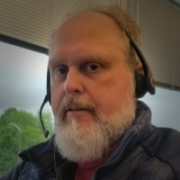

Sean Wheeler Nexus Louisiana Become immediately effective with PowerShell

Slide 10
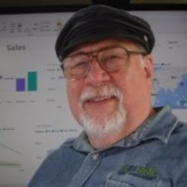
Russel Loski Nexus Louisiana Jumpstart Your Power BI Skills A hands on Workshop

Slide 11
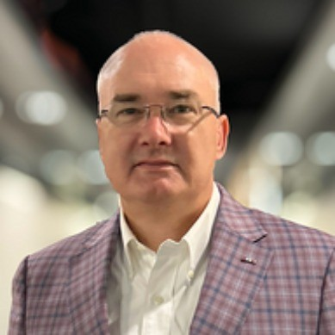
James Davis KEYNOTE SPEAKER AUDITORIUM 10:45AM ARTIFICIAL INTELLGENCE The Tale of Two Interns

Slide 12
Auditorium
Session Evaluations
TIME | Name | Level | Session Title
8:30 AM | James Davis | Intermediate | Hashing: The Cornerstone of Blockchain Security and Data Integrity
9:40 AM | Grant Fritchey | Intermediate | Identify Poorly Performing Queries - Three Tools You Already Own
10:45 AM |  | KEYNOTE : James Davis | Artificial Intelligence: The Tale of Two Interns Auditorium 1510
11:20 AM | Cory Murray, Bryan Fuselier | Intermediate | PrAIctical Engineering
12:20 PM |  | LUNCH AND SPONSORS | ATRIUM - Rotunda Commons
1:40 PM | Jonathan Stewart | Intermediate | Building Scalable Data Warehouses with Microsoft Fabric:
2:45 PM | Tim Radney | Intermediate | Common SQL Server Mistakes and How to Avoid Them
3:45 PM |  | RAFFLE AND CLOSING | Auditorium 1510

Slide 13
BEC 1220
Session Evaluations
ANALYTICS
TIME | Name | Level | Session Title
8:30 AM | Jason Romans | Intermediate | How to Diagnose a Slow Power BI Report
9:40 AM | Kevin Feasel | Intermediate | Applying Forensic Accounting Techniques using SQL and Python
10:45 AM |  | KEYNOTE : James Davis | Artificial Intelligence: The Tale of Two Interns Auditorium 1510
11:20 AM | Kristyna Ferris | Intermediate | Mastering Microsoft Fabric Data Warehousing: Tips & Tricks You Need to Know
12:20 PM |  | LUNCH AND SPONSORS | ATRIUM - Rotunda Commons
1:40 PM | Doug Leal | Introductory and overview | Cutting Through the Buzz: LLM, Agents, RAG, and GPT - Making Sense of Generative AI
2:45 PM | Srikanth Kumar Rana | Introductory and overview | Unlocking Insights using Natural Language on Databricks Genie Spaces
3:45 PM |  | RAFFLE AND CLOSING | Auditorium 1510

Slide 14
BEC 1225
Session Evaluations
Professional Development
TIME | Name | Level | Session Title
8:30 AM | Warren Sifre | Introductory and overview | Leadership Principles Uncovered...
9:40 AM | Ava McClain | Introductory and overview | How to Manage Recruiters and Hiring Managers in the Job Search
10:45 AM |  | KEYNOTE : James Davis | Artificial Intelligence: The Tale of Two Interns Auditorium 1510
11:20 AM | Michael Viron | Intermediate | Careers in IT Baton Rouge 2025
12:20 PM |  | LUNCH AND SPONSORS | ATRIUM - Rotunda Commons
1:40 PM | David McCarter | Introductory and overview | Röck Yoür Cäreer: Time-Tested Wisdom from a 30-Year Software Engineering Veteran
2:45 PM | Tanya Boyd | Intermediate | Tales from the SWAMP: Navigating the Murky Waters of Project Management
3:45 PM |  | RAFFLE AND CLOSING | Auditorium 1510

Slide 15
BEC 1305
Session Evaluations
PowerShell | Automation
TIME | Name | Level | Session Title
8:30 AM | Mike Robbins | Intermediate | Mastering PowerShell Functions and Script Modules: Build, Reuse, and Share Your Code Like a Pro
9:40 AM | Dominick Raimato | Intermediate | Extending Power BI with Power Automate
10:45 AM |  | KEYNOTE : James Davis | Artificial Intelligence: The Tale of Two Interns Auditorium 1510
11:20 AM | Steven Judd | Introductory and overview | Don't Bash PowerShell
12:20 PM |  | LUNCH AND SPONSORS | ATRIUM - Rotunda Commons
1:40 PM | Joe Houghes | Intermediate | Getting Super Geeky with PowerShell Notebooks - It's Easy!
2:45 PM | Brian Davis | Advanced | Mastering Cursor: We're All Cooked (But in a Good Way)
3:45 PM |  | RAFFLE AND CLOSING | Auditorium 1510

Slide 16
BEC 1325
Session Evaluations
.NET Development
TIME | Name | Level | Session Title
8:30 AM | Tommy Parrish | Intermediate | Rapid Prototyping in the Age of AI
9:40 AM | Sean Wheeler | Intermediate | Learn the basics of Git and GitHub workflow
10:45 AM |  | KEYNOTE : James Davis | Artificial Intelligence: The Tale of Two Interns Auditorium 1510
11:20 AM | Jeremy Knight | Intermediate | The Developer Testing Toolbox
12:20 PM |  | LUNCH AND SPONSORS | ATRIUM - Rotunda Commons
1:40 PM | Ryan Richard | Introductory and overview | Intro to Angular
2:45 PM | Ben Miller | Intermediate | SQL Server Configuration Best Practices
3:45 PM |  | RAFFLE AND CLOSING | Auditorium 1510

Slide 17
BEC 1409
Session Evaluations
CLOUD I
TIME | Name | Level | Session Title
8:30 AM | John Deardurff | Intermediate | Business Continuity in Azure SQL Databases
9:40 AM | Jared Rhodes | Advanced | Microsoft Fabric and Azure Health Data Services
10:45 AM |  | KEYNOTE : James Davis | Artificial Intelligence: The Tale of Two Interns Auditorium 1510
11:20 AM | Muralidhar Chouhan | Intermediate | The Rise of AI Agents: What You Need to Know
12:20 PM |  | LUNCH AND SPONSORS | ATRIUM - Rotunda Commons
1:40 PM | Alvaro Costa-Neto, Chetan Nandikanti | Intermediate | SQL Server Hosting on AWS: Options and Considerations
2:45 PM | David Pless, Abdullah Mamun | Intermediate | Managing SQL Server with Azure Arc Unleashed
3:45 PM |  | RAFFLE AND CLOSING | Auditorium 1510

Slide 18
BEC 1425
Session Evaluations
CLOUD II
TIME | Name | Level | Session Title
8:30 AM | Barkha Herman | Introductory and overview | The Collision of Real-Time Analytics and Observability
9:40 AM | Paresh Motiwala | Intermediate | Using Digital Forensics for Data Loss Prevention (DLP)
10:45 AM |  | KEYNOTE : James Davis | Artificial Intelligence: The Tale of Two Interns Auditorium 1510
11:20 AM | Ian Trimble | Intermediate | Automate Your Documentation with Local AI
12:20 PM |  | LUNCH AND SPONSORS | ATRIUM - Rotunda Commons
1:40 PM 2:00 PM 2:20 PM | Russel Loski Sravanthi Akavaram Mike Sammartino | Lightning Round I Lightning Round II Lightning Round III | Connecting Power BI to API using POST Secure Communication Protocol for Distributed Env. Squeezing the Apple for All Its Juice
2:45 PM 3:05 PM 3:25 PM | Nilanjan Chatterjee Garo Yeriazarian Dr. Srikanth Bangaru | Lightning Round I Lightning Round II Lightning Round III | Who Needs a Warehouse When You've Got a Lakehouse? Getting Started Getting Started with Containerization Agentic AI in Construction – Transforming the Industry with Intelligent Solutions
3:45 PM |  | RAFFLE AND CLOSING | Auditorium 1510

Slide 19
BEC 1920
Session Evaluations
Security
TIME | Name | Level | Session Title
8:30 AM | Christopher Long | Advanced | High speed failover Clustering with RDMA/ROCE with Hyper-v over converged multigigabit networks
9:40 AM | Rachel Arnold | Intermediate | Strength in Partnerships: Cybersecurity and the Value of Vendor Management
10:45 AM |  | KEYNOTE : James Davis | Artificial Intelligence: The Tale of Two Interns Auditorium 1510
11:20 AM | Ben Miller | Introductory and overview | SQL Server 2025: an enterprise AI-ready database platform
12:20 PM |  | LUNCH AND SPONSORS | ATRIUM - Rotunda Commons
1:40 PM | Miguel Solis | Intermediate | Let’s Hack a Database
2:45 PM | Ricky Tucker | Introductory and overview | Narrative as a Design Tool
3:45 PM |  | RAFFLE AND CLOSING | Auditorium 1510

Slide 20
BEC 2520
Session Evaluations
SQL Server Development
TIME | Name | Level | Session Title
8:30 AM | Kevin Pereira | Introductory and overview | Streamlining DataOps in Fabric: Implementing Azure DevOps CI/CD Pipelines for Fabric SQL DB
9:40 AM | Calvin Fabre | Advanced | Modeling Software Development Problems in Time and Thinking Temporally
10:45 AM |  | KEYNOTE : James Davis | Artificial Intelligence: The Tale of Two Interns Auditorium 1510
11:20 AM | George Mauer | Intermediate | README.md? We Can Do Better!
12:20 PM |  | LUNCH AND SPONSORS | ATRIUM - Rotunda Commons
1:40 PM | Glenn Rumfellow | Intermediate | Natural Language Queries with ASP.NET
2:45 PM | Jeff Foushee | Intermediate | The T-SQL JSON Operators
3:45 PM |  | RAFFLE AND CLOSING | Auditorium 1510

Slide 21
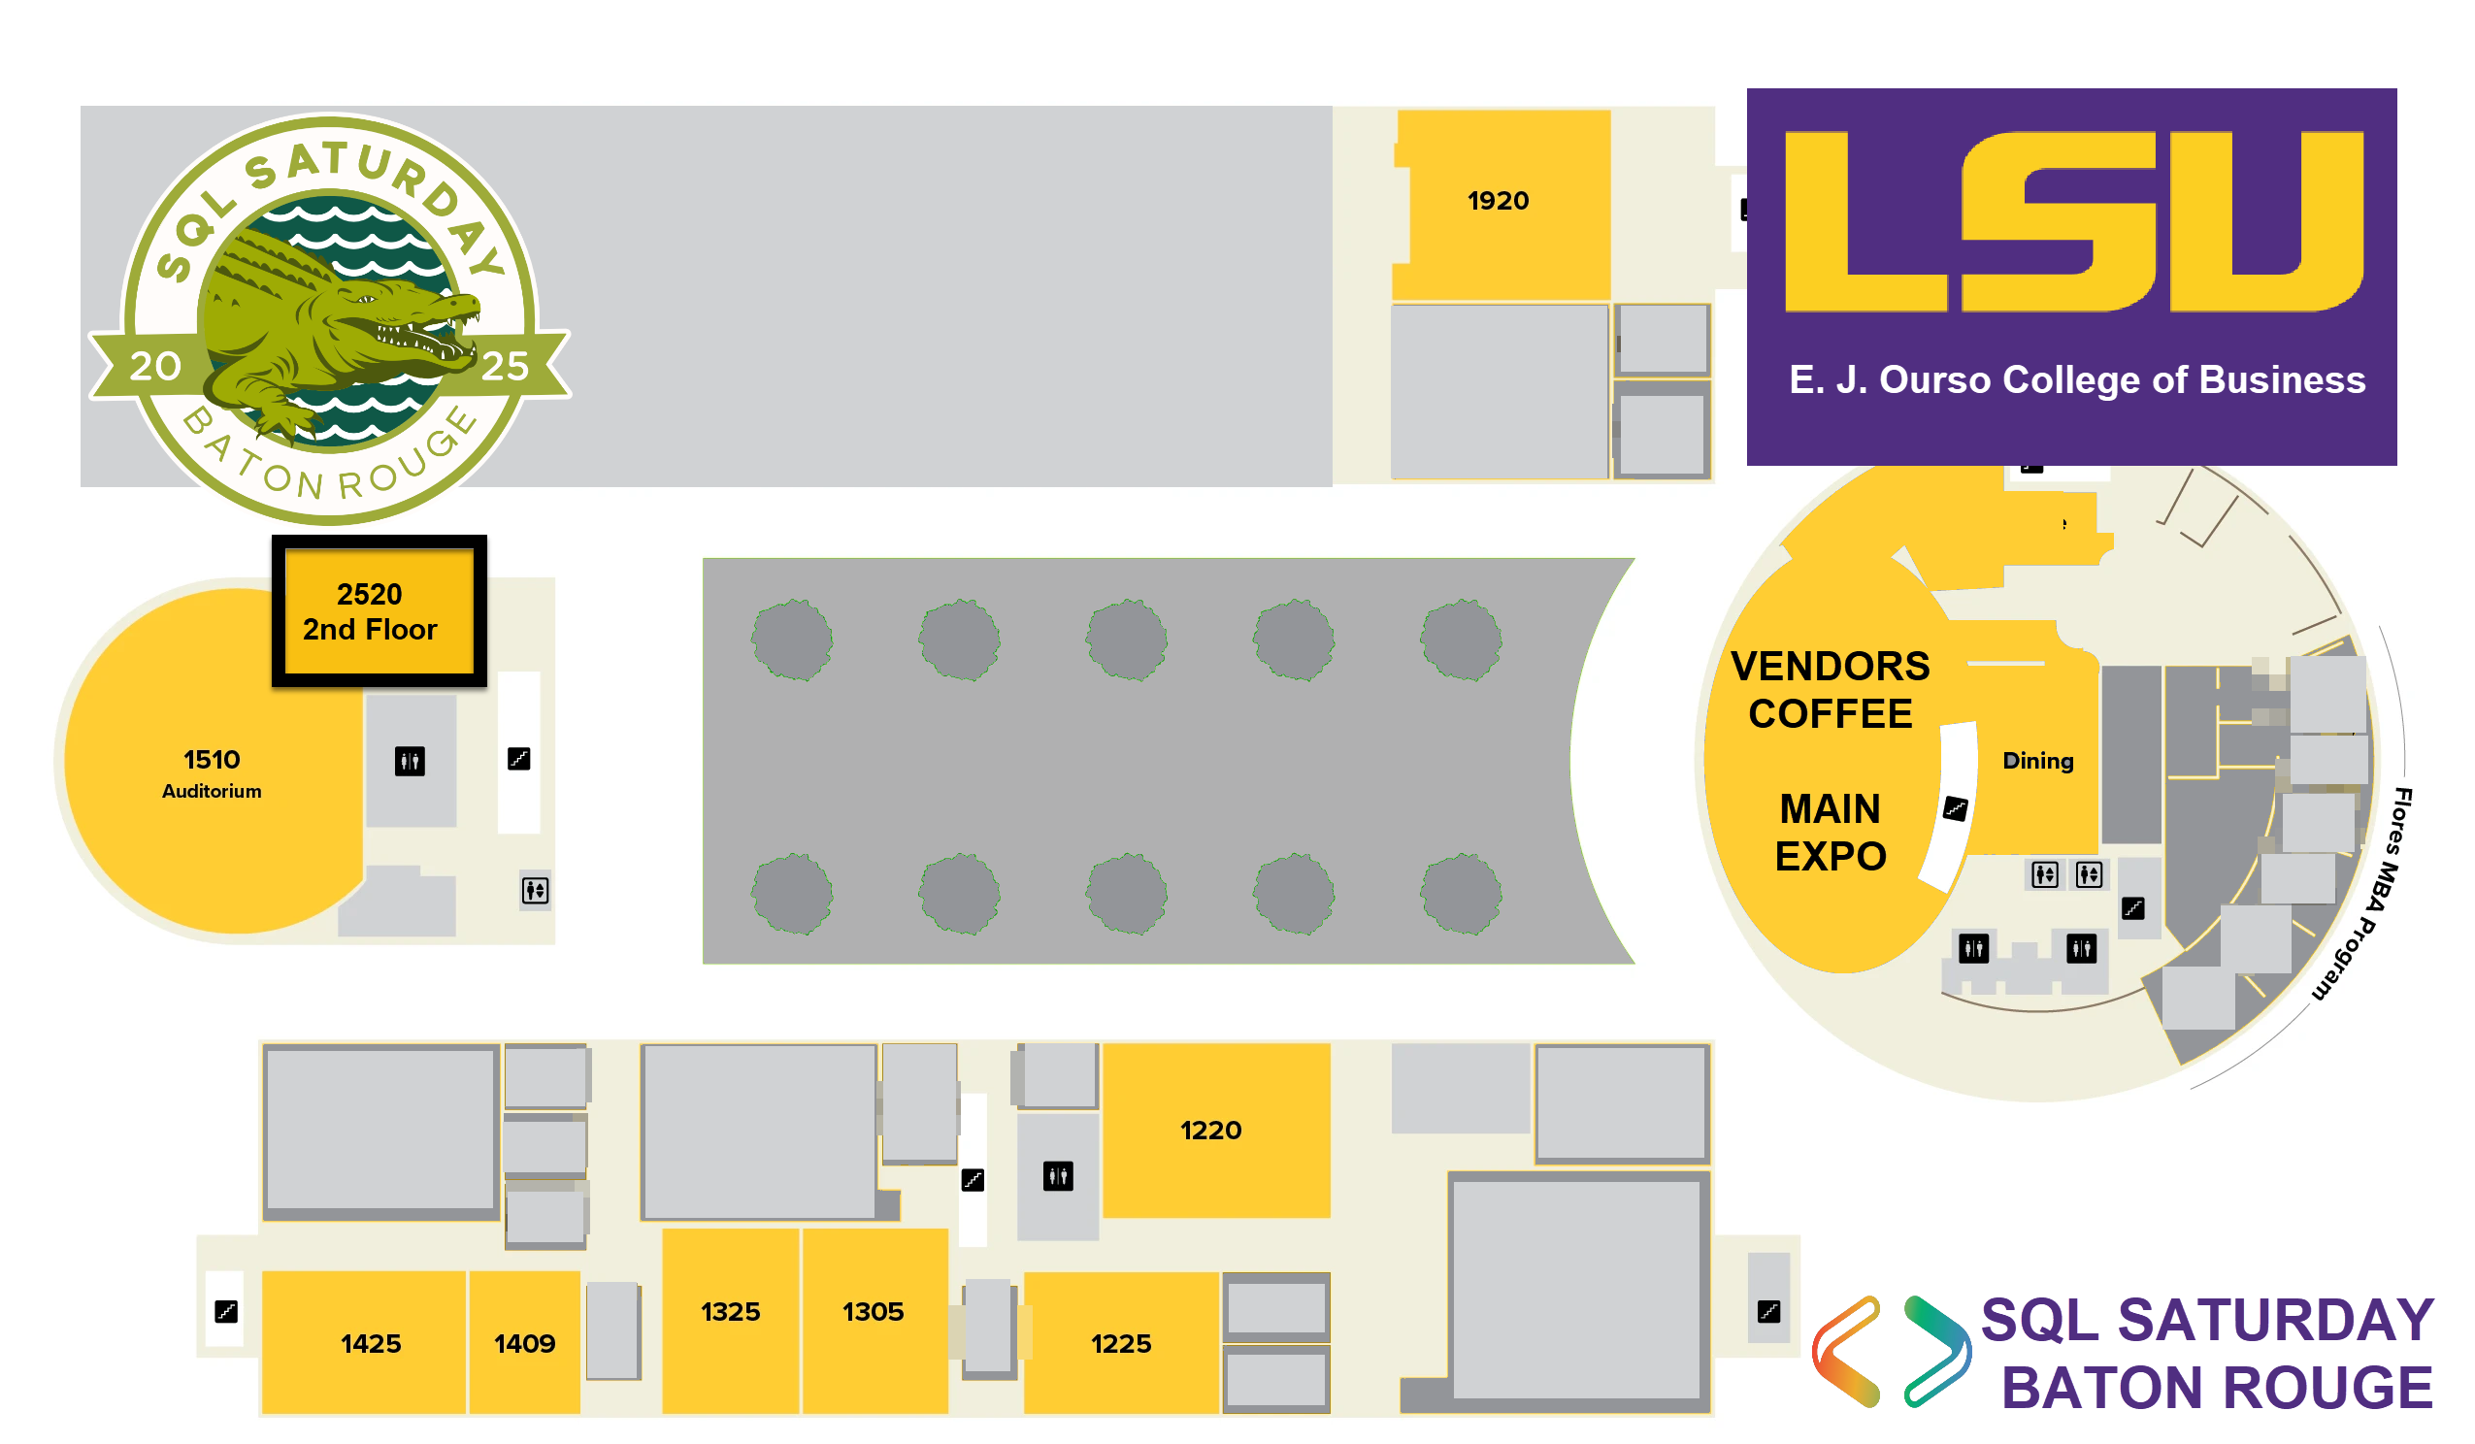

Slide 22
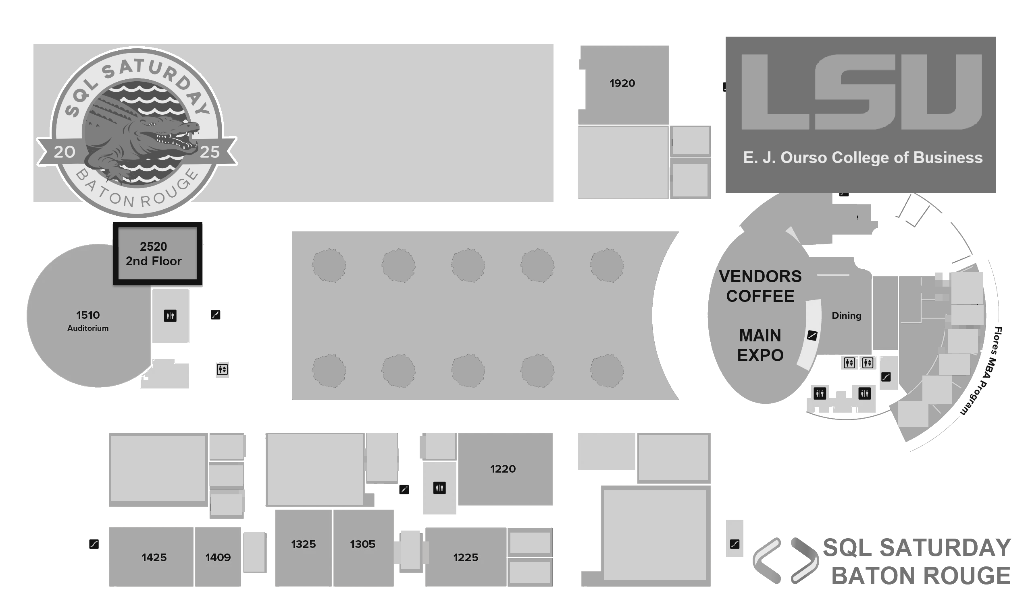

Slide 23
DO NOT PRINT BELOW THIS SLIDE

Slide 24


BATON ROUGE DOT NET USER GROUP
BRDNUG.ORG

Slide 25


BATON ROUGE SQL SERVER USER GROUP
BRSSUG.ORG

Slide 26


https://www.linkedin.com/company/baton-rouge-user-groups

Slide 27


Locked out? Message "BRNUG LockedOut" to 225-267-7761
Gobrain.org

Slide 28


SQL
Saturday

Slide 29
SQL
Saturday

Slide 30
SQL
Saturday

